Slide 1
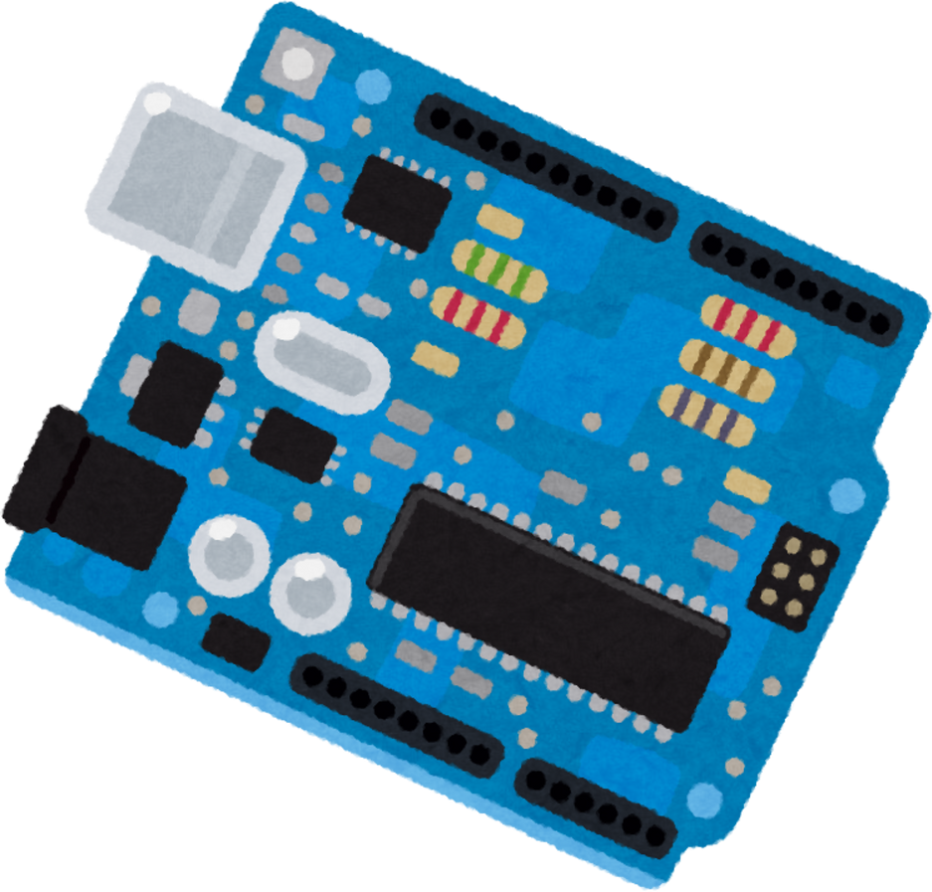
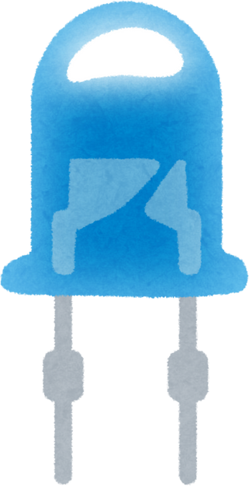
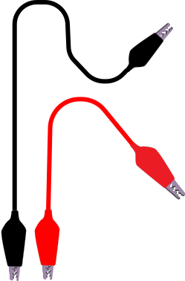






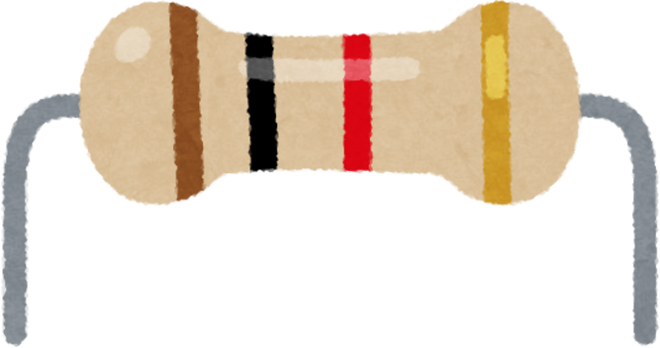
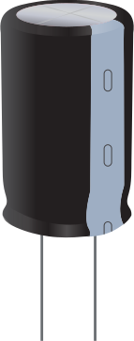
Sensor Squad

Slide 2


Slide 3
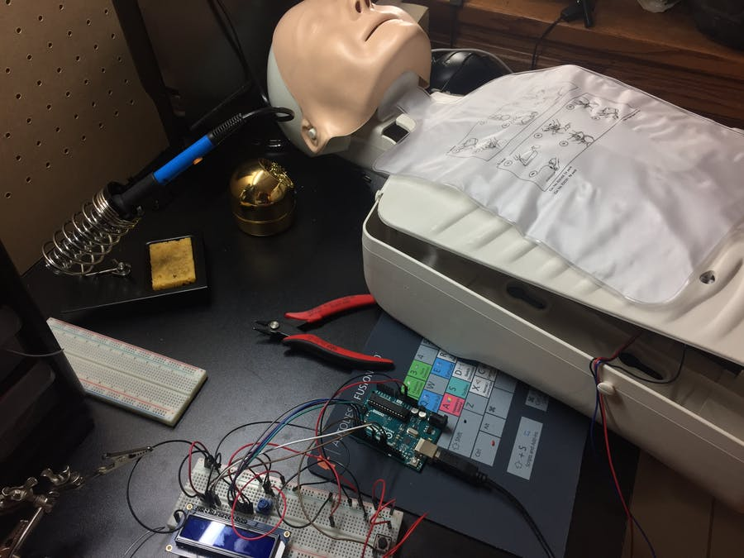
The picture shows an Arduino-based CPR feedback device connected to a CPR manikin. The device provides real-time feedback on depth, rate, time, and chest recoil

Slide 4
Algorithm
1-Setup
2-Main Loop
Define the modes for the pins (input/output) for the button, LEDs.
- Initialize serial communication (Serial) and the LCD display.
Display the message "Begin CPR" on the LCD.
Read the pressure value from the pressure sensor (pressurePin).
Read the state of the CPR button (buttonPin).

Slide 5
3-Check for Button State Change:
4-Update LED Status Based on Pressure Reading:
If the button state has changed, check if the current state is HIGH:
- If the state is HIGH, increment the CPR count (cprCount).
- Display the current CPR count on the LCD.
- If this is the first compression, record the start time (timeBegin).
If the pressure reading is less than 500, turn on the green LED (pressGood) and turn off the red LED (pressBad).
If the pressure reading is 500 or more, turn on the red LED (pressBad) and turn off the green LED (pressGood).
.

Slide 6
5-Calculate BPM After 30Compressions:
- If the CPR count reaches 30:
- Reset the CPR count (cprCount) to 0.
- Record the end time (timeEnd).
- Calculate the total time for the compressions (totalTime) in seconds.
- Calculate the compressions per minute (BPM).
- Display the BPM and total time on the LCD.
- Increment the cycle count (cprCycle).
- If the cycle count reaches 5, reset it to 0.

Slide 7
6-Provide Real-Time Feedback on CPR Rate:
7-Short Delay for Stability and Update Last Button State:
- If the CPR count is greater than 5 and less than or equal to 30:
- Calculate the elapsed time since the start of the compressions (rateTime).
- Calculate the current rate of compressions (rate).
- Display "Good" if the rate is between 100 and 120, or "----" if it is outside this range.
- Delay for 25 milliseconds.
- Update the last button state to be the current state.
.

Slide 8

Writing instructions
Arduino Board:
- The Arduino is connected to other components on a breadboard.

Slide 9
Writing instructions
LCD Screen:
- VSS: Connected to ground (GND) on the Arduino.
- VDD: Connected to 5V on the Arduino.
- V0: Connected to a potentiometer for contrast adjustment.
- RS: Connected to pin 12 on the Arduino.
- RW: Connected to ground (GND).
- E: Connected to pin 11 on the Arduino.
- D4-D7: Connected to pins 5, 4, 3, 2 on the Arduino, respectively.

Slide 10
Writing instructions
Pressure Sensor:
The pressure sensor is connected to the analog input A0 on the Arduino.

Slide 11
Writing instructions
LEDs:
Green LED:
- Cathode (negative) connected to ground (GND).
- Anode (positive) connected to a resistor, which is then connected to pin 10 on the Arduino.
- Red LED:
- Cathode (negative) connected to ground (GND).
- Anode (positive) connected to a resistor, which is then connected to pin 9 on the Arduino.

Slide 12
Writing instructions
Button:
- One leg of the button is connected to pin 8 on the Arduino.
- The other leg of the button is connected to ground (GND)..

Slide 13
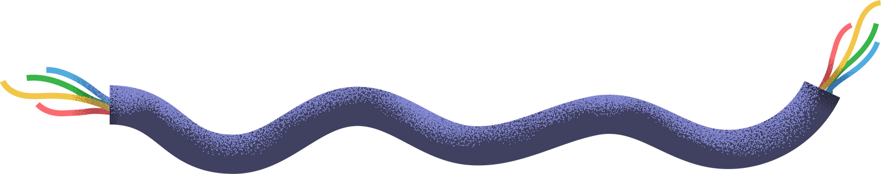
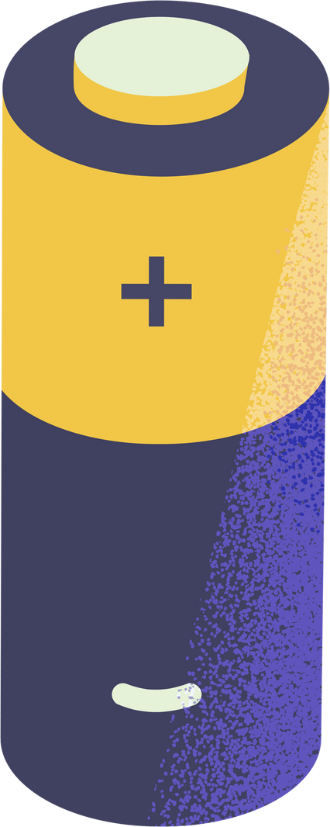
Connection
Summary
WITH THE HELP OF YOUR TEACHER OR CARER,
test whether your suggestions and drawings will make the bulb light using actual batteries, a small lightbulb, and wires.
- LCD: Connected to Arduino through digital pins 12, 11, 5, 4, 3, and 2.
- Pressure Sensor: Connected to analog input A0.
- Green LED: Connected to digital pin 10.
- Red LED: Connected to digital pin 9.
- Button: Connected to digital pin 8.

Slide 14

CODE
#include <LiquidCrystal.h>
// Pin definitions
int pressurePin = A0; // Analog pin for pressure sensor
int buttonPin = 8; // Digital pin for CPR button
int pressGood = 10; // Digital pin for good pressure LED (Green)
int pressBad = 9; // Digital pin for bad pressure LED (Red)
// Variables for calculations and states
int pressureRead;
int BPM;
float bpmCount;
float cprCount = 0;
int buttonState = 0;
int lastButtonState = 0;
int cprCycle = 0;
float totalTime;
unsigned long timeBegin, timeEnd;
// LCD configuration
LiquidCrystal lcd(12, 11, 2, 3, 4, 5);

Slide 15
CODE
void setup()
{
// Pin modes
pinMode(buttonPin, INPUT);
pinMode(pressGood, OUTPUT);
pinMode(pressBad, OUTPUT);
// Initialize serial communication and LCD
Serial.begin(9600);
lcd.begin(16, 2);
lcd.home();
lcd.print("Begin CPR");
}

Slide 16
CODE
void loop() {
pressureRead = analogRead(pressurePin);
buttonState = digitalRead(buttonPin);
// Check if button state has changed
if (buttonState != lastButtonState) {
if (buttonState == HIGH) {
cprCount++; // Increment CPR count
lcd.clear();
lcd.print("Count: ");
lcd.print(cprCount);
// Record start time on first compression
if (cprCount == 1) {
timeBegin = millis();
}
}
}

Slide 17
CODE
// Update LED based on pressure reading
if (pressureRead < 500) {
digitalWrite(pressGood, HIGH);
digitalWrite(pressBad, LOW);
} else {
digitalWrite(pressBad, HIGH);
digitalWrite(pressGood, LOW);
}
// Calculate BPM after 30 compressions
if (cprCount == 30) {
cprCount = 0;
timeEnd = millis();
totalTime = (timeEnd - timeBegin) / 1000.0;
bpmCount = 30.0 / totalTime;
BPM = bpmCount * 60;
lcd.clear();
lcd.print("Rate (BPM): ");
lcd.print(BPM);
lcd.setCursor(0, 1);
lcd.print("Total Time: ");
lcd.print(totalTime);
cprCycle++;

Slide 18
CODE
// Reset cycle count after 5 cycles
if (cprCycle == 5) {
cprCycle = 0;
}
}
// Provide real-time feedback on CPR rate
if (cprCount > 5 && cprCount <= 30) {
float rateTime = (millis() - timeBegin) / 1000.0;
int rate = (cprCount / rateTime) * 60;
lcd.setCursor(12, 0);
if (rate >= 100 && rate <= 120) {
lcd.print("Good");
} else {
lcd.print("----");
}
}
delay(25); // Short delay for stability
lastButtonState = buttonState; // Update last button state
}

Slide 19

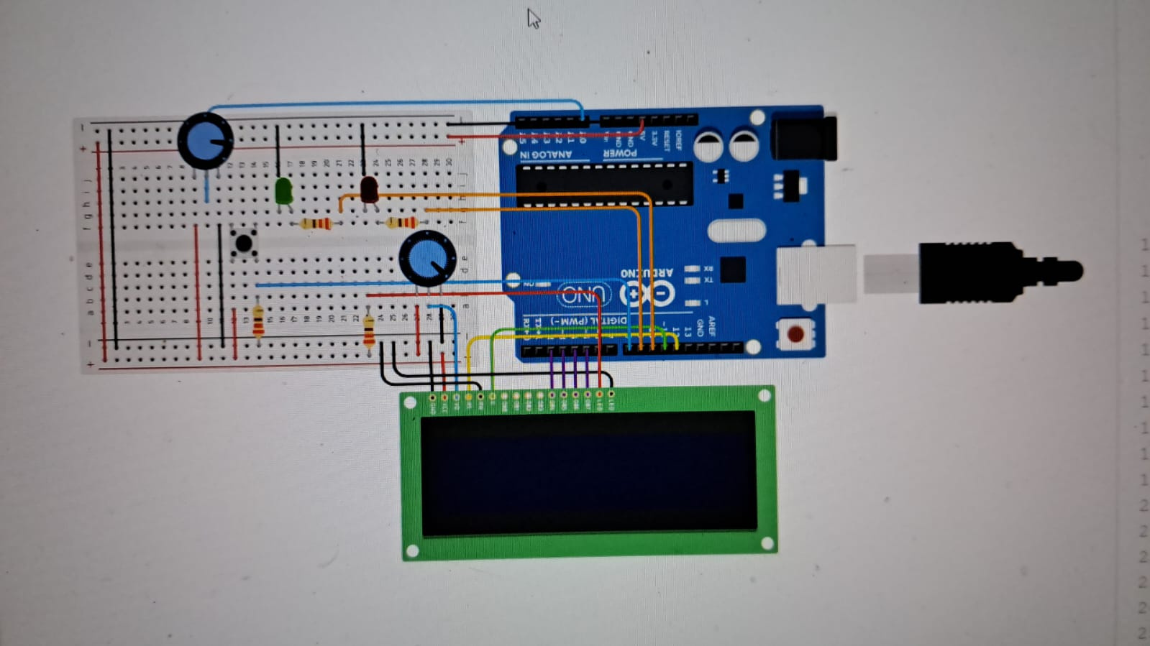
Picture for the simulation

Slide 20
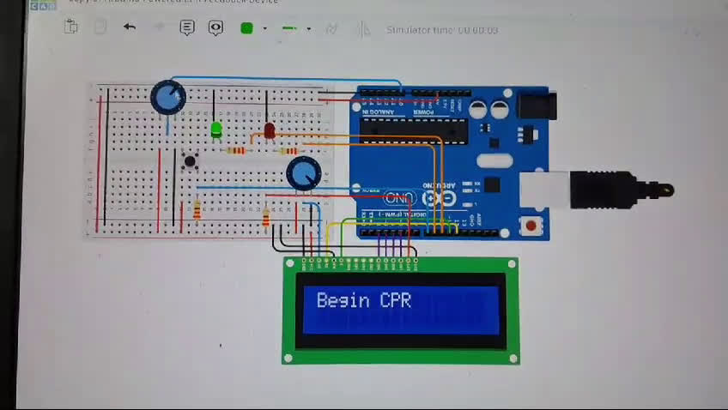
Video for our project

Slide 21
sensor squad team... safe life

Slide 22

Asia Belal
Menna Amgad
Nada Mostafa
Hager Gomaa
Team Members

